Slide 1
Renthub Rental Listings Analysis Jianhua Xu 2017/03/30

Slide 2
Problem
Hiring competition from Kaggle.com
Designed by Two Sigma and Renthub
NYC rental listings
Goal – predict interest level based on listing information

Slide 3
Dataset Columns
bathrooms: # bathrooms
bedrooms: # bedrooms
building_id
created: created time
description
display_address
features: a list of features
latitude
listing_id
longitude
manager_id
photos: a list of photo links. 85G of photos
price: in USD
street_address
interest_level: target variable 'high', 'medium', 'low'

Slide 4
Exploratory Analysis

Slide 5
Cleaning a bit
49532 records and 15 columns
No nulls(cleaned up before posting on Kaggle)
Drop building_id, manager_id, and listing_id
Drop display_address and street_address
Replace interest level {‘low’:0,’medium’:1,’high’:2}

Slide 6
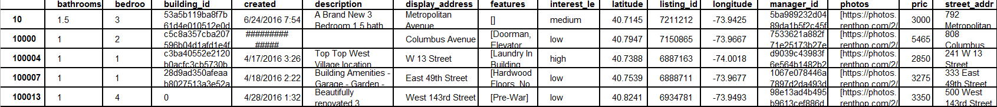
Original data sample

Slide 7
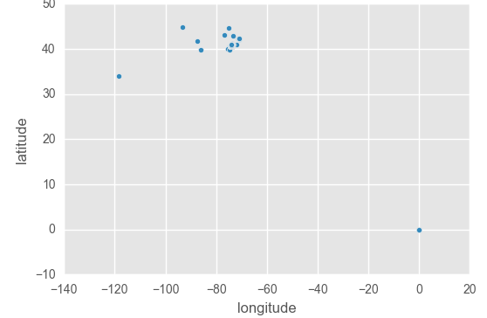
Latitude and Longitude
How to remove outliners
Check NYC borders on Google map
Latitude[40.496217,40.910596], longitude[-75.255653,-73.701978].
Loose the numbers 0.5 to exclude outliners.

Slide 8
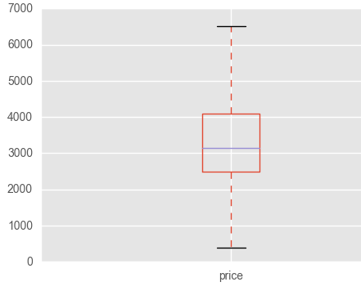
Price
Outliners with price > 100k
Almost all have 1 bedrooms and 1 bathroom
Consider them as mistaken input

Slide 9
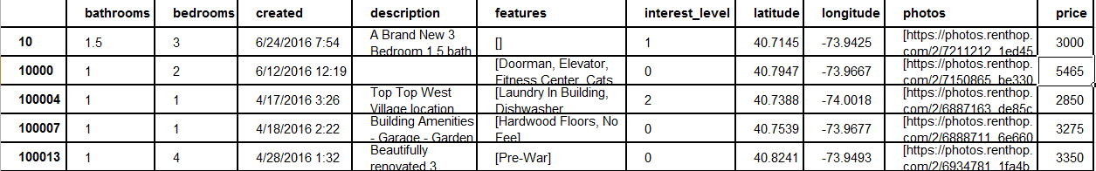
Data still messy

Slide 10
Features Engneering

Slide 11
created
Date and time when the listing was created
Most of them are unique and too many for categorical variable
Extract month to model after seasonality

Slide 12
Photos
Links to the photos of the listing
Total 85G. Hard to utilize the data
More photos tend to be better(life experience)
Count the number of links

Slide 13
Latitude and Longitude
Too many for categorical variable
Convert them into zip/neighborhood
Use Google maps API
Difficulities
One pair of request a time through API
Google Throttles requests(50K requests)
Limitation of request per day per account
Response could be bad
Use sleep, try/except, multiple accounts, early am, 3hrs

Slide 14
Description and Features
Text
Original thought – identifies words sentiment, good(+1), neutral(0), bad(-1) and sum up
Eventually use less aggressive method - word counts
Reasoning – owners almost only say good things about the listing.
countVectorizer

Slide 15
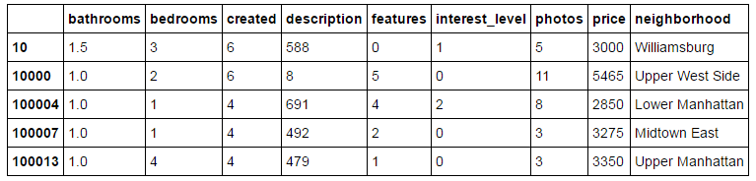
We have a clean dataset

Slide 16
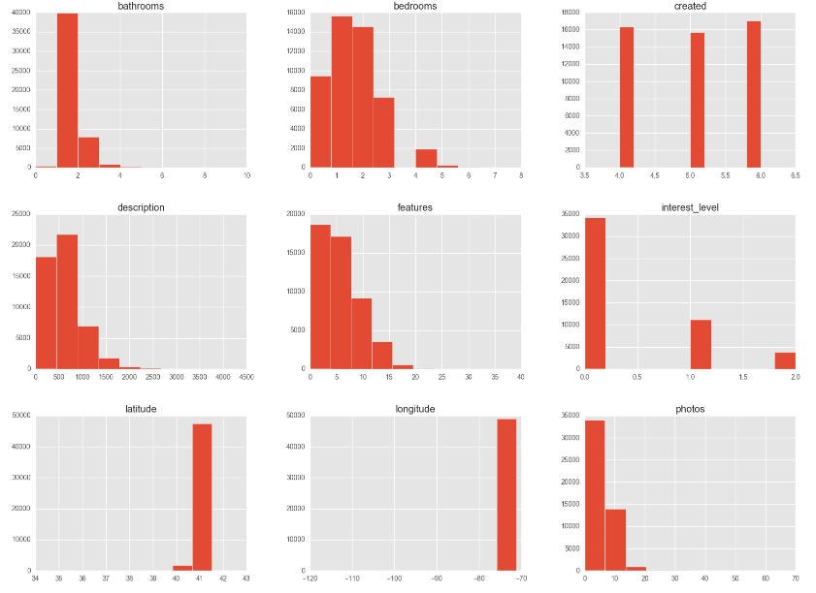
Graphs

Slide 17
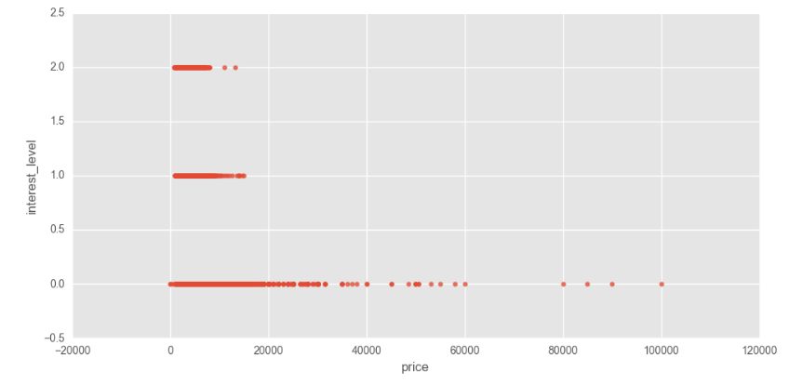
Price vs intreste_level

Slide 18
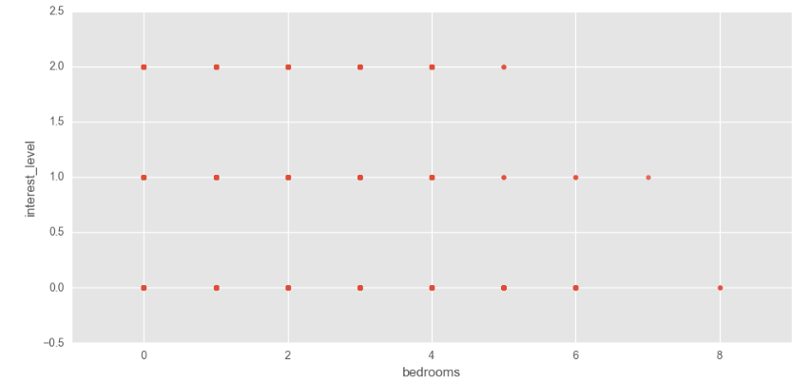
Bedrooms vs interest_level

Slide 19
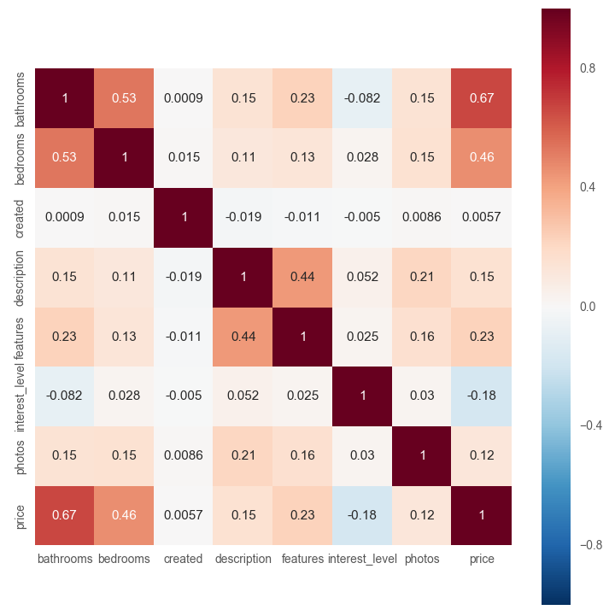
Correlation heatmap

Slide 20
Modeling

Slide 21
Categorical Variables
Month
Neighborhood
147 columns after set up dummies
49081 records after cleaning up

Slide 22
Note
Multicalss problem(0,1,2) instead of binary
Grid_searchCV not working for multiclass
Hard to draw ROC(have to do pair-wise)
Hard to calculate AUC(have to do pair-wise)
Use Confusion and precision_score as main metrics

Slide 23
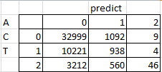
Logistic Regression
Precision_score(weighted) = 0.6367
Confusion matrix

Slide 24
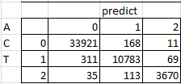
Random Forest Tree
Depth = 135
Precision score= 0.9855
Confusion Matrix

Slide 25
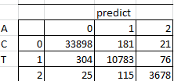
Random Forest Tree with countVectorizer
Depth=165
Precision score=0.9852
Confusion Matrix

Slide 26
Why Mode with CountVectorizer worse
Word count effective due to owners say good things
Could be depth not fine tuned
Different ways to calculate precsion score
 | no countVectorizer | countVectorizer
weighted | 0.98554 | 0.98524
micro | 0.9856 | 0.98529
macro | 0.98074 | 0.98081

Slide 27
countVectorizer better
No countVectorizer
With countVectorizer

Slide 28
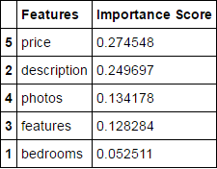
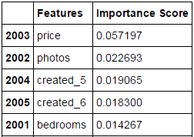
Importance Score
Without countVectorizer
With countVectorizer

Slide 29
Conclusion
With Random Forest Tree model and Random Forest Tree with countVectorizer, we can predict the interest level >98% based on listing information

